Slide 1

Predicting the success of a bank tele marketing campaign
Methodology and ML model

Slide 2


General Architecture
ML Model
Training
Machine Learning Algorithm
Data
Write
Python
+
Flask
Prediction (REST API Call)
User

Slide 3
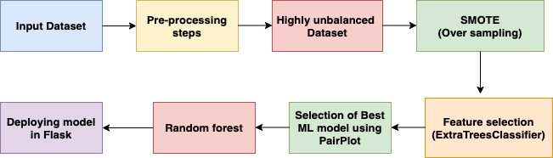
Step-by-step approach

Slide 4
Input-Dataset
From input dataset, as it contains the ‘target’ value to be predicted for the given input features.
This problem can be achieved with an approach of Supervised ML model.
Let’s explore more about dataset with EDA (Exploratory Data Analysis stage).

Slide 5
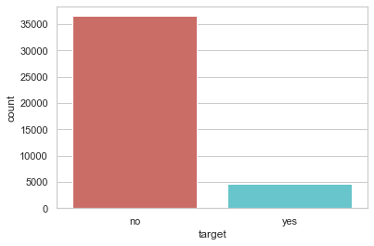
Pre-processing and EDA
Next step, it to pre-process the dataset like to identify the numerical and categorical features.
Find any missing values.
Checking the count based on categorical features, to see how features are creating the impact. After checking the ’target’ variable count.
It is clearly an imbalanced dataset which contains NO=‘0.88%’ , YES=‘0.11’
So we need to perform SMOTE-oversampling technique to make the balanced dataset.
Notebook link: (visuals&smote.ipynb)

Slide 6
Feature Selection
New dataset created after SMOTE and conversion of categorical features contains 63 columns.
It is not feasible to tarin the model with these many features, as model will suffer from over fitting.
So we will select the features using technique “ Extra Tree classifier”
This identifies the topmost 10 features that creates an impact with the target feature.

Slide 7
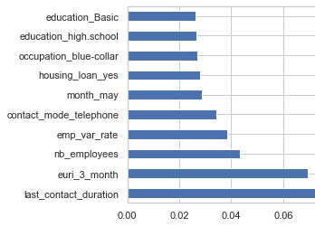
Cont..
The graph is plotted for better understanding
Notebook link: (model.ipynb)
Top 10 features

Slide 8

Selecting Best ML model
As there are many different ML model but choose the best model is quite challenging task.
This can be done with technique called “Pair Plot”.
The visualizations between features and predicted values, makes us clear which ML model will be selected for this problem statement.
As from visuals, it is seen clearly that there is high over lap between different features and so we cannot apply Logistic regression as LR is more suitable to draw the best fit line between the features.
So we can apply either Random forest, xgboost or Decision trees.
Notebook link: (pariplot.ipynb)

Slide 9
Random Forest Classifier
Ensemble of decision trees.
It aggregates the votes from different decision trees to decide the final class of the object.
Can be used for both regression and classification problem.
Easy to measure relative importance of each feature on the prediction.

Slide 10
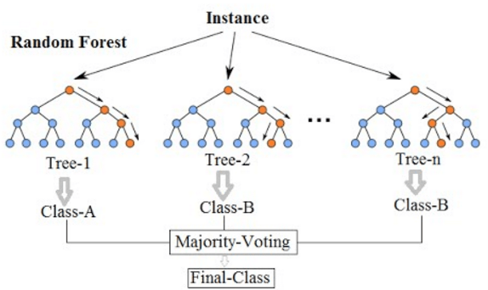
Cont.

Slide 11
Random-Forest ML model
After pair plot, it is more suitable to apply Random Forest
After selecting top 10 features and converting predicted value into label encoding, applied Random forest with n_estimators=20
This model gives the accuracy of 93%.
Notebook link: (model.ipynb)
 | Precision | Recall | F1-score | Support
0 | 0.94 | 0.92 | 0.93 | 7651
1 | 0.92 | 0.94 | 0.93 | 7697
Confusion matrix

Slide 12

ML Model Deployment
Model is deployed using flask on local host.
The link for website is as follows :
Screen shot of Web site for Predicting the success of a bank marketing campaign

